Slide 1
To be fAIr
Ethical and Fair Application of Artificial Intelligence in Virtual Laboratories
Fiammetta Caccavale, Carina L. Gargalo, Krist V. Gernaey, Ulrich Krühne
Technical University of Denmark (DTU)
21/09/2022

Slide 2
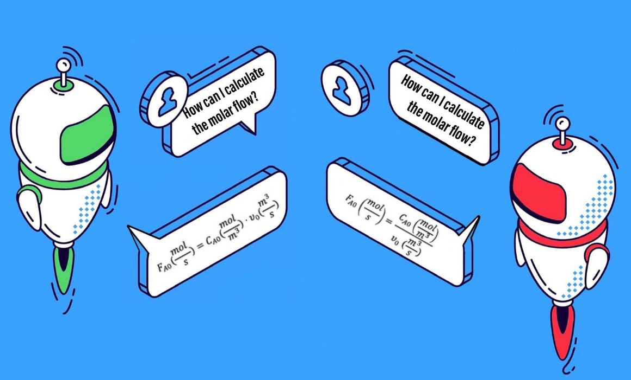
Current opportunities in Education
Educational disruption
Covid-19 pandemic
Fourth Industrial Revolution
Virtual laboratories (VL) offer a solution to provide inclusive learning opportunities
Artificial intelligence (AI) is becoming an integral part of new educational platforms
Notes:
(e.g., grading assignments, tutoring, developing smart content, personalizing learning).

Slide 3
Ethical concerns of AI in Education
“The human-centric approach to AI strives to ensure that human values are central to the way in which AI systems are developed, deployed, used and monitored, by ensuring respect for fundamental rights, including those set out in the Treaties of the European Union and Charter of Fundamental Rights of the European Union, all of which are united by reference to a common foundation rooted in respect for human dignity, in which the human being enjoys a unique and inalienable moral status.” [1]
Lack of strict regulations, only non-binding guidelines – rely on individual ethics rather than providing a solid code of conduct
Some resources:
[1] EU guidelines on ethics in artificial intelligence: Context and implementation (2019). https://www.europarl.europa.eu/RegData/etudes/BRIE/2019/640163/EPRS_BRI(2019)640163_EN.pdf
[2] Recommendation on the ethics of artificial intelligence. https://en.unesco.org/artificial
[3] Preliminary study on the Ethics of Artificial Intelligence (2019). https://unesdoc.unesco.org/ark:/48223/pf0000367823
[4]World Commission on the Ethics of Scientific Knowledge and Technology (COMEST). https://en.unesco.org/themes/ethics-science-and-technology/comest
Notes:
Data is very valuable, however not protected

Slide 4
Ethical aspects to be assessed
Fairness and bias – correct algorithm bias for decision-making
Is the data distribution skewed? Can this have an impact on the results?
Do I use the data in a correct way?
Could there be any risks resulting from my implementation being public?
Equity and inclusion – enhance culturally inclusive learning
Am I considering the diversity of my audience?
Is my material accessible to my target group?
Data transparency and digital rights – transparency contract with the users
Do the users know if and what kind of data is being collected?
How is the data being used?
Notes:
Correcting algorithm bias

Slide 5

Collaborative approach between disciplines
Engineers and computer scientists should have a formal ethics education
Solutions and guidelines to the “ethics crisis” should be perceived as a transversal problem and solved as a collaborative effort between disciplines [5]
Illustration by Praxie.com
[5] Raji ID, Scheuerman MK, Amironesei R. (2021), You Can't Sit With Us: Exclusionary Pedagogy in AI Ethics Education. In Proceedings of the 2021 ACM Conference on Fairness, Accountability, and Transparency (FAcct ’21), 515-525. https://dl.acm.org/doi/epdf/10.1145/3442188.3445914

Slide 6
Proposed framework
Propose a framework to ensure a more ethical and safe virtual experience for learners, where every aspect of the “digital contract” is transparent
Four checkmarks to assess the ethical application of AI to virtual laboratories:
Clarify scope and purpose
Ensure transparency
Protect users’ privacy
Help students – the ultimate goal

Slide 7

Clarify scope and purpose
Define a clear scope and purpose for data collection to set ethical boundaries
→ To be done before starting to collect and use data
→ Establish a plan for how data is used and, new assessment if the plan changes
Image from: https://www.eiresystems.com/managing-scope-creep-in-it-project-management/

Slide 8

Ensure transparency
Assess the quality and fairness of the data before using it as input to data-driven models
→ Build control into the design of implemented algorithms
→ Probe the model for understanding salient features learned
Image from: https://www.elsevier.com/connect/what-should-journals-do-to-promote-transparent-and-responsible-research

Slide 9
Protect users’ privacy
Transparent contract with the students on how their data is being stored and used
→ Clearly describe the process and ensure transparency with the students
→ Possibly allow for students to revise their selected preferences on data sharing at a later stage

Slide 10

Help students – the ultimate goal
Solutions implemented should be directed towards the goal of helping students
→ Allow students to share concerns about their digital rights and ask questions
Illustration by upklyak

Slide 11
Take away and future directions
Propose a framework to follow in order to ensure a more ethical and safe virtual experience for learners, where every aspect of the “digital contract” is transparent
Stress the need for collaborative effort across disciplines in establishing clear regulations to safeguard students and their digital rights
Spur other researchers and practitioners working on Engineering Education to contribute with reflections and resources in the future

Slide 12
Thank you!
If you have any additional questions, please address them to: fiacac@kt.dtu.dk

